Slide 1
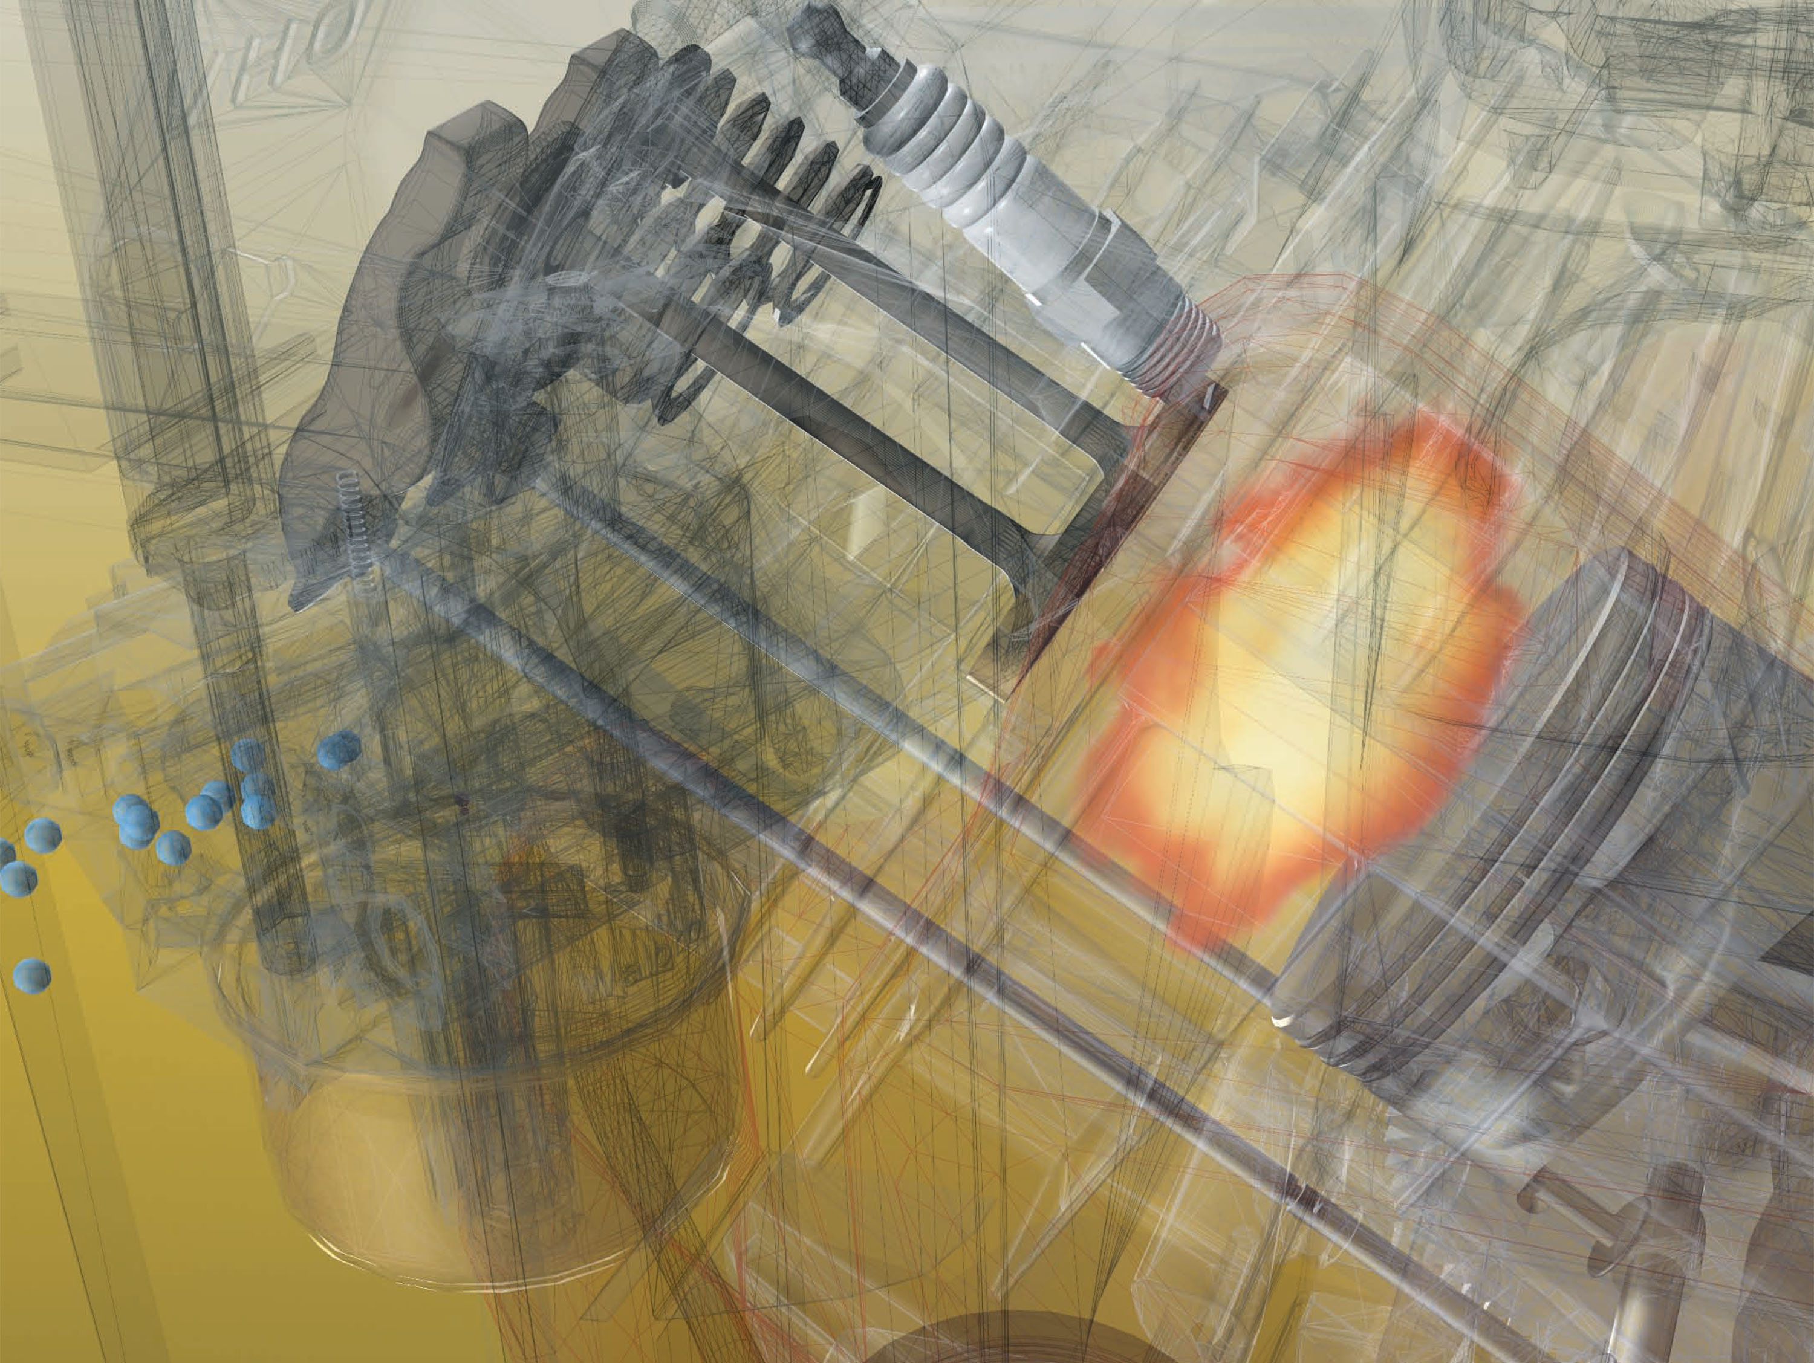
Customer Education
Basic Engine Systems
4 Cycle Theory (L-Head & Overhead Valve) Valves, Basic Carburetion,
Governors, Compression Ratio, Rings and Displacement
CE3017-10/11
Disclaimer: These images are not intended to be used as assembly aids. For assembly or parts orientation detail, always see the appropriate repair manual for the engine in question. May not be used in any publication, web, or video without permission of the Customer Education Department.

Slide 2
Engine Identification
Model
Type
Code
126312 0023 E1 040922 FD
OEM Specific info (color, decals, speed...etc)
Year
Cubic Inch Displacement
Month
Type of Starter
Day
Basic Design Series
Emissions
(“G” = CARB Compliant)
Type of Bearing, Reduction Gear, Auxiliary Drive, Lubrication
Assembly Line and Manufacturing Plant
Crankshaft Orientation
CE3017-10/11 of 86 .

Slide 3
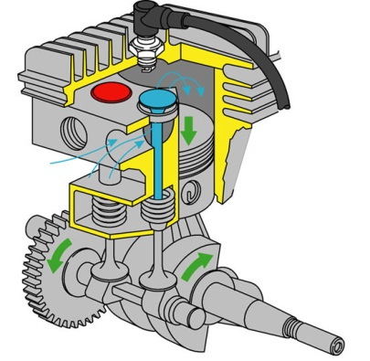
1. Intake Stroke
L-HEAD
CE3017-10/11 of 86 .

Slide 4
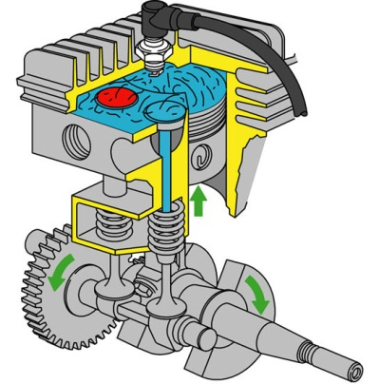
2. Compression Stroke
L-HEAD
CE3017-10/11 of 86 .

Slide 5
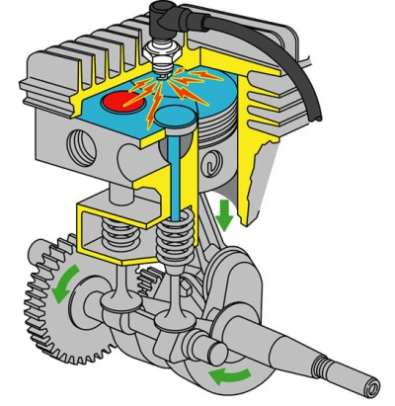
3. Power Stroke
L-HEAD
CE3017-10/11 of 86 .

Slide 6
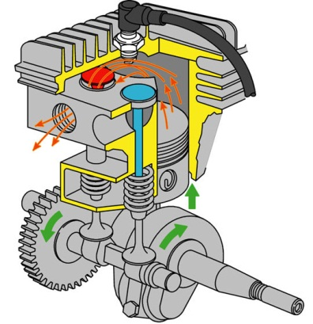
4. Exhaust Stroke
L-HEAD
CE3017-10/11 of 86 .

Slide 7
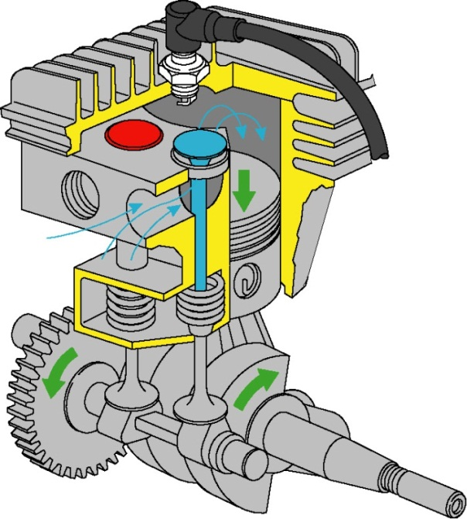
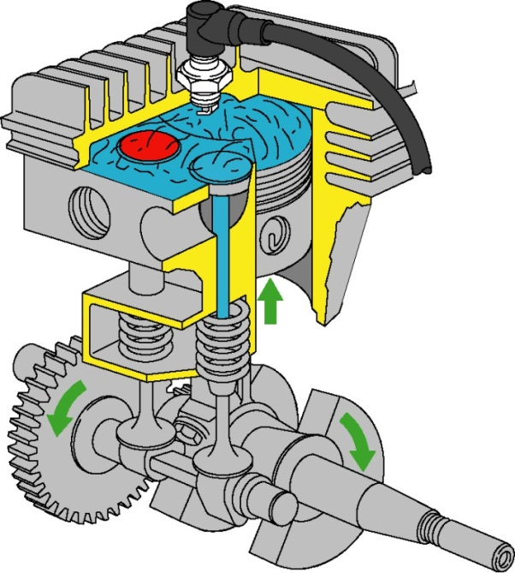
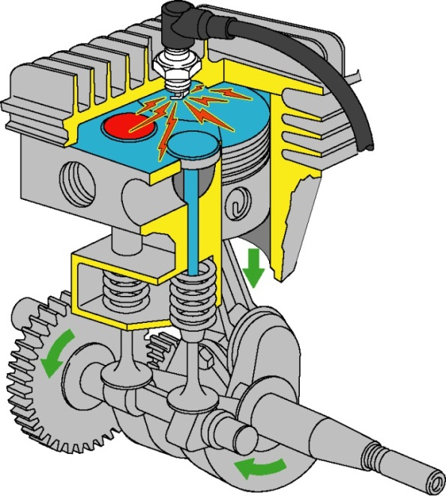
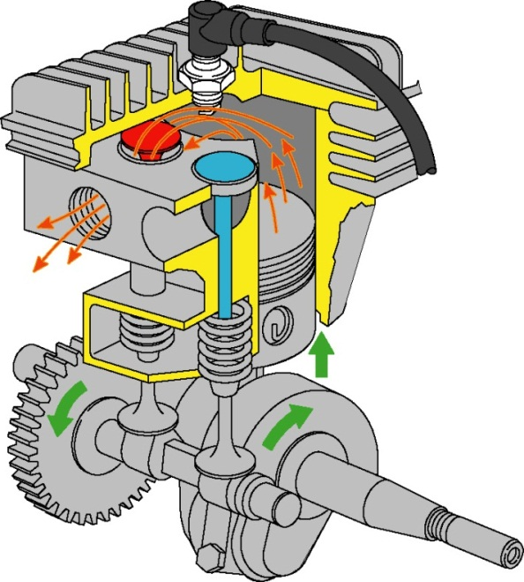
INTAKE
COMPRESSION
POWER
EXHAUST
L-HEAD
CE3017-10/11 of 86 .

Slide 8
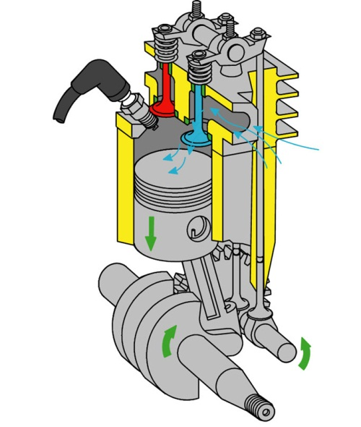
1. Intake Stroke
OHV
OHV
8
CE3017-10/11 of 86 .
CE3017-6/11 of 86 .

Slide 9
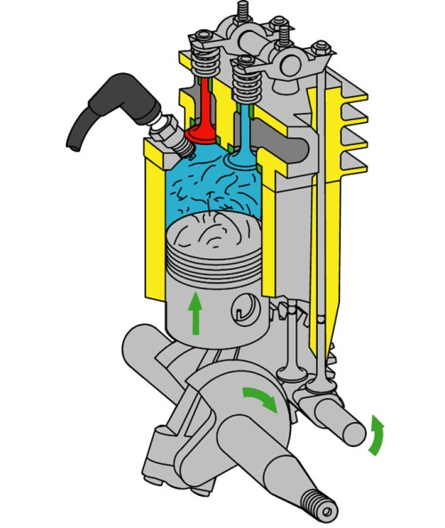
2. Compression Stroke
OHV
CE3017-10/11 of 86 .

Slide 10
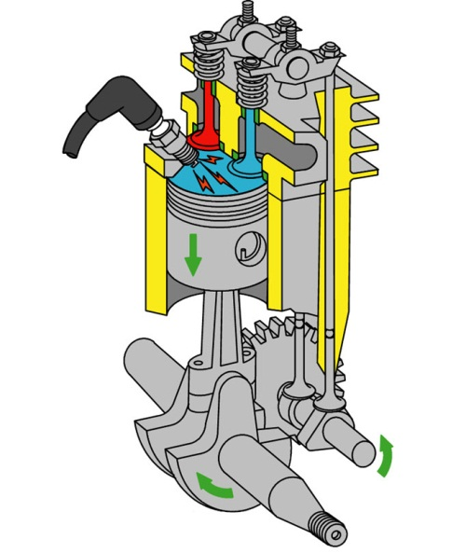
3. Power Stroke
OHV
CE3017-10/11 of 86 .

Slide 11
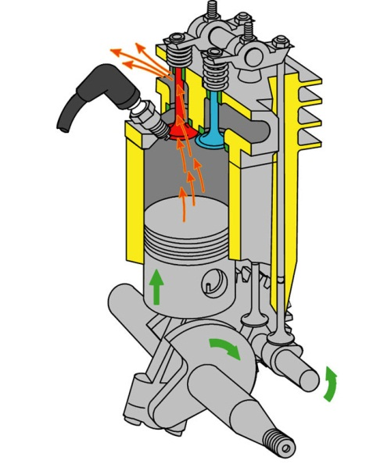
4. Exhaust Stroke
OHV
CE3017-10/11 of 86 .

Slide 12
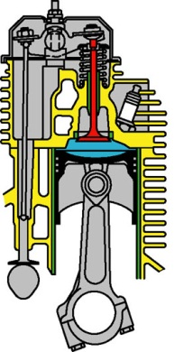
Valve Cover
Gap Adjustment
Push Rod
Cylinder
Tappet
Camshaft
Components
4-Stroke Theory
CE3017-10/11 of 86 .

Slide 13
Valve Spring
Valve
Spark Plug
Combustion Chamber
Piston
Connecting Rod
Components
4-Stroke Theory
CE3017-10/11 of 86 .

Slide 14
4-Stroke Theory
CE3017-10/11 of 86 .

Slide 15
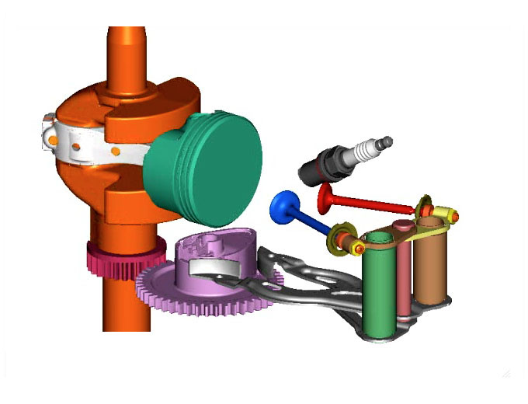
Shows Crank Rotation
Piston Movement
CAM Rotation
Intake Valve Opens
1. DOV® INTAKE STROKE
CE3017-10/11 of 86 .

Slide 16
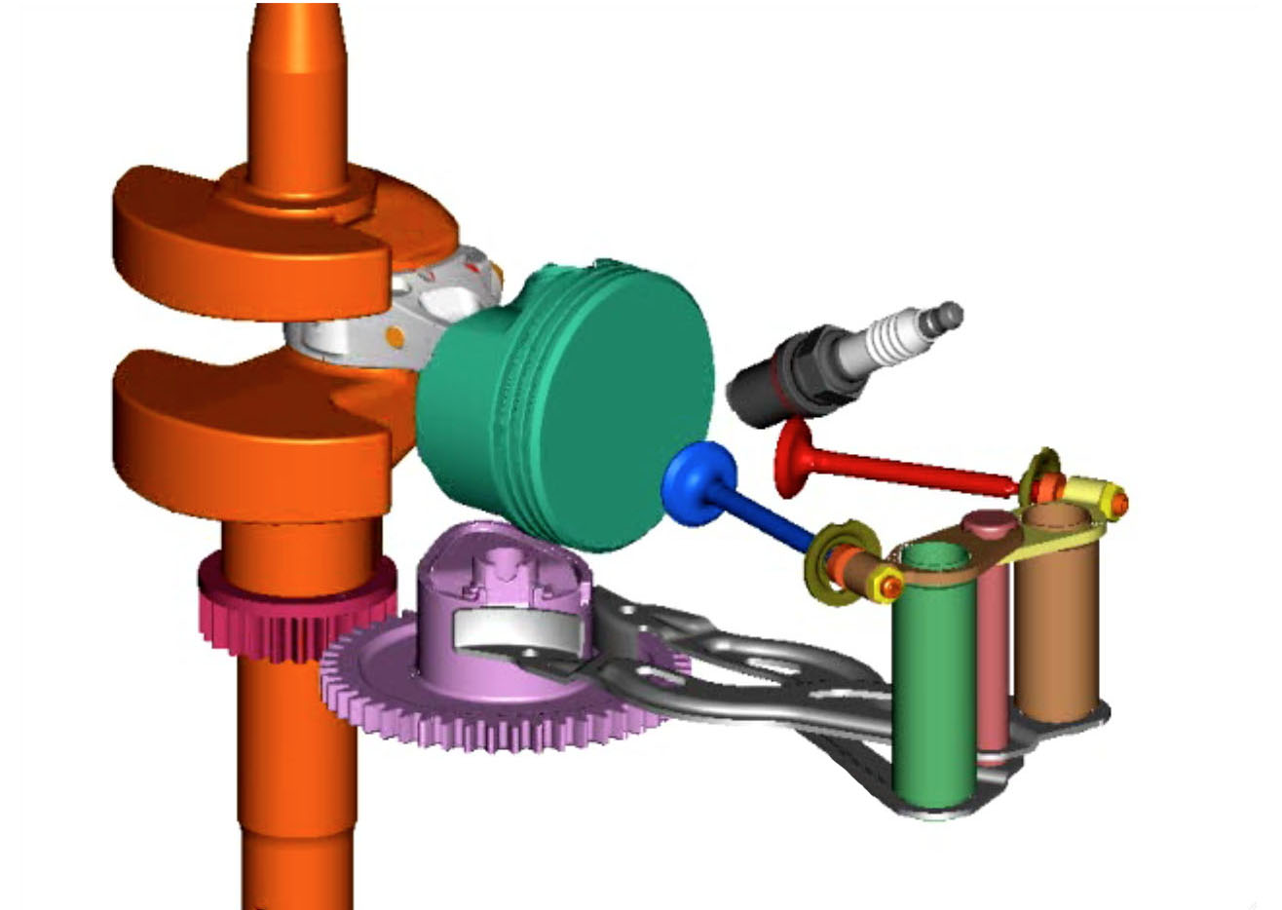
Shows Crank Rotation
Piston Movement
CAM Rotation
Intake Valve Closes
2. DOV® COMPRESSION STROKE
CE3017-10/11 of 86 .

Slide 17
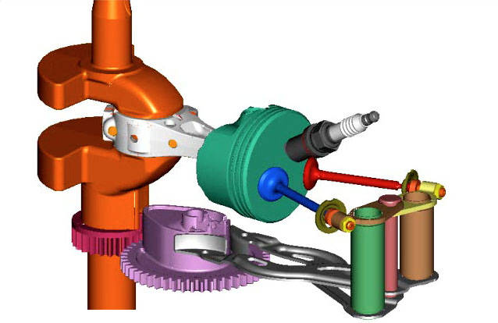
Shows Crank Rotation
Piston Movement
CAM Rotation
3. DOV® POWER STROKE AT TDC
CE3017-10/11 of 86 .

Slide 18
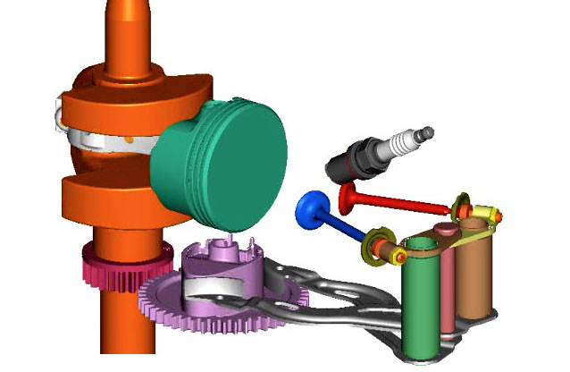
Shows Crank Rotation
Piston Movement
Exhaust Valve
Begins to Open
CAM Rotation
4. DOV® EXHAUST STROKE
CE3017-10/11 of 86 .

Slide 19
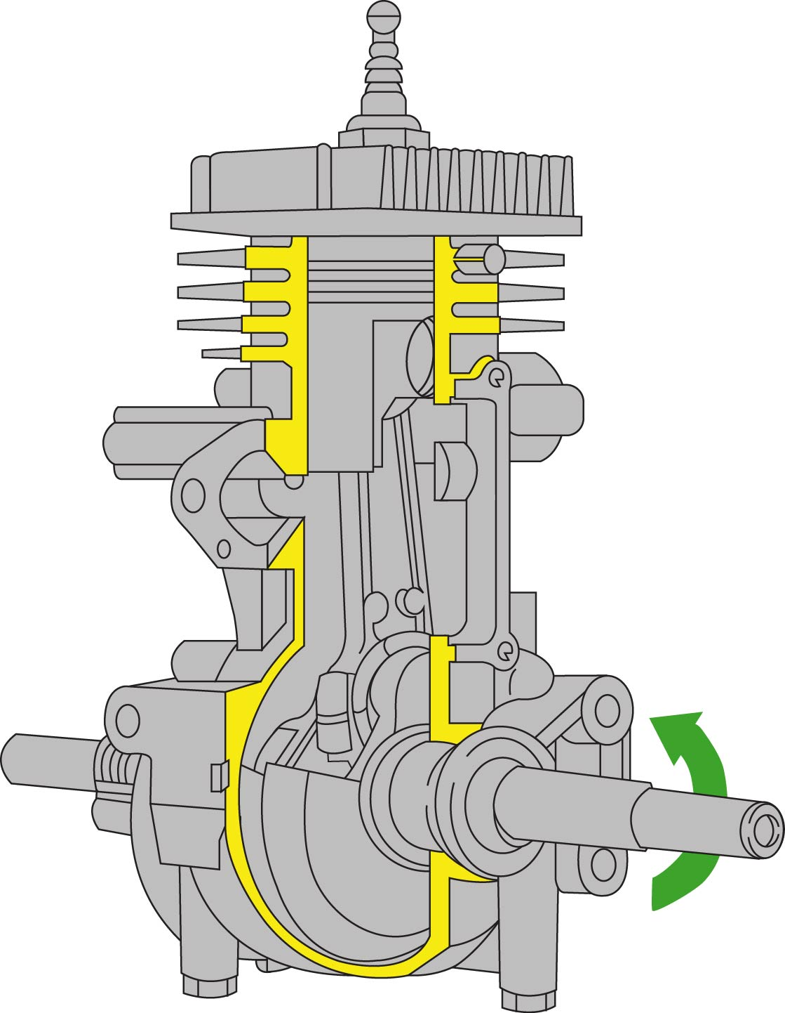
Intake Port
1. Intake and Compression Stroke
2-CYCLE “PISTON PORT STYLE”
CE3017-10/11 of 86 .

Slide 20
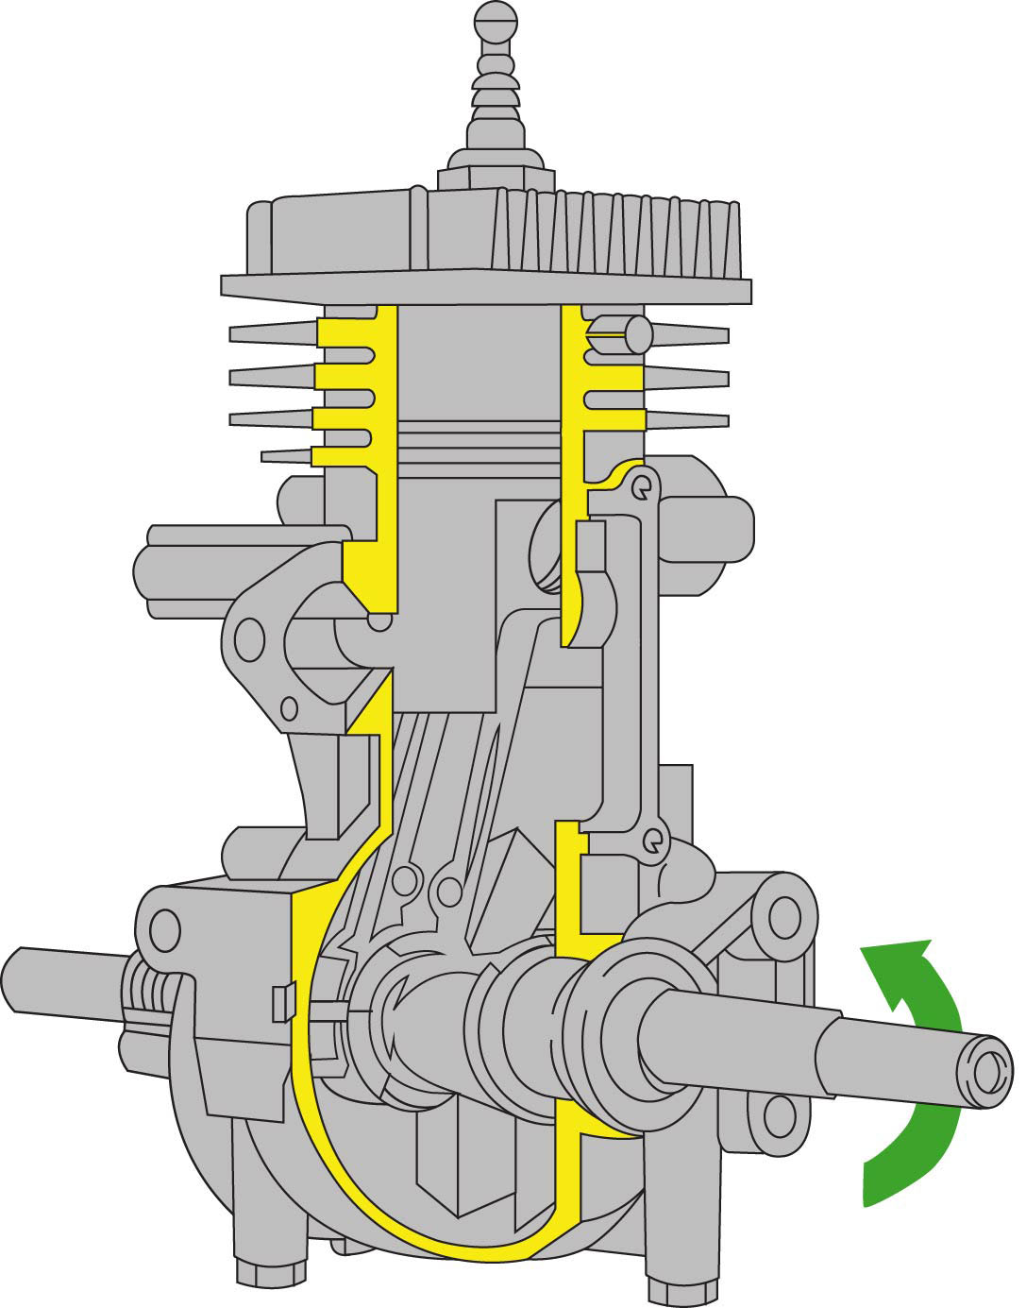
Transfer Port
2A. Power and Exhaust
2-CYCLE “PISTON PORT STYLE”
CE3017-10/11 of 86 .

Slide 21
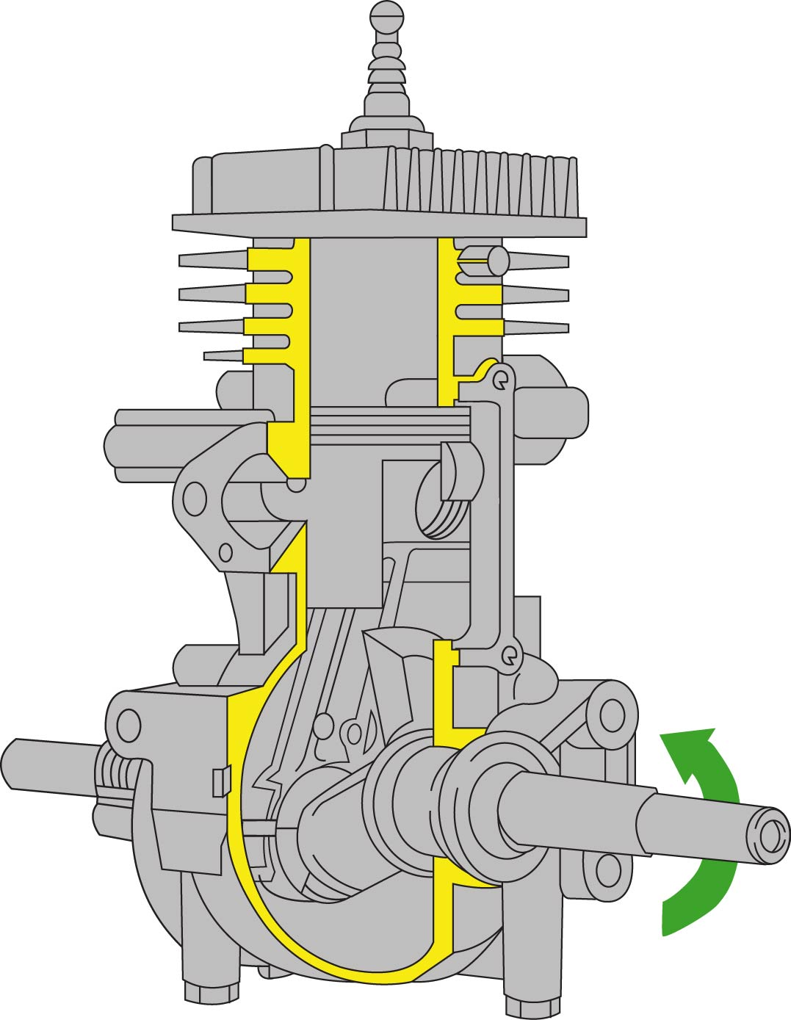
Exhaust Port
2B. Exhaust and Transfer
2-CYCLE “PISTON PORT STYLE”
CE3017-10/11 of 86 .

Slide 22
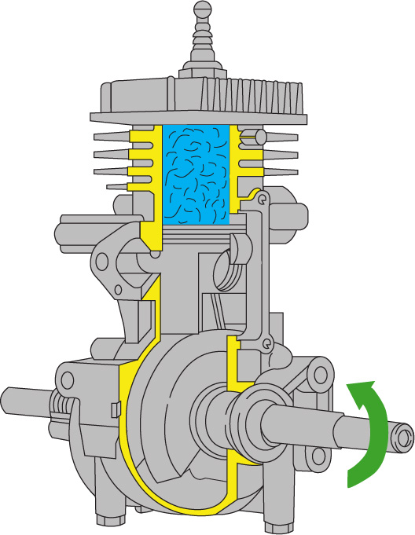
Transfer Port for Fresh Fuel and Oil Mix
3. Intake Fuel Oil Mix Transfer and Compression Begins
2-CYCLE “PISTON PORT STYLE”
CE3017-10/11 of 86 .

Slide 23
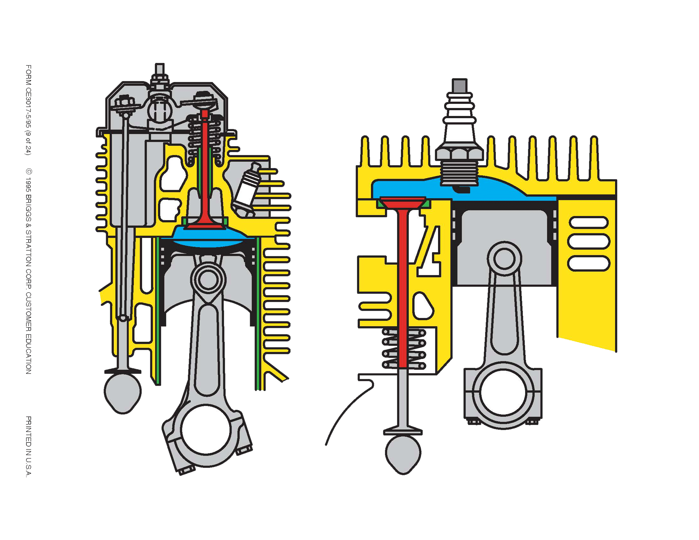
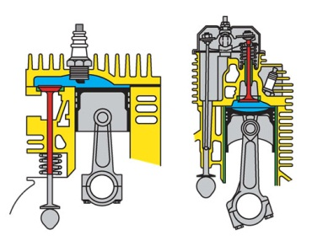
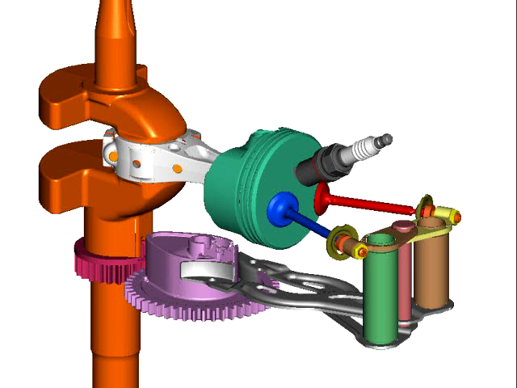
L-Head
OHV
DOV®
CE3017-10/11 of 86 .

Slide 24
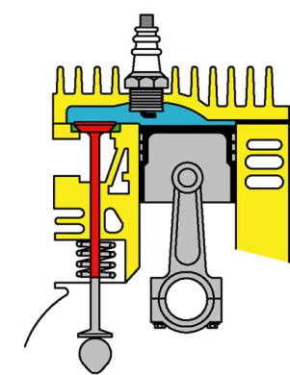
Large Combustion
Chamber
Side Valve
4-STROKE THEORY
CE3017-10/11 of 86 .

Slide 25
Small Combustion
Chamber
4-STROKE THEORY
CE3017-10/11 of 86 .

Slide 26
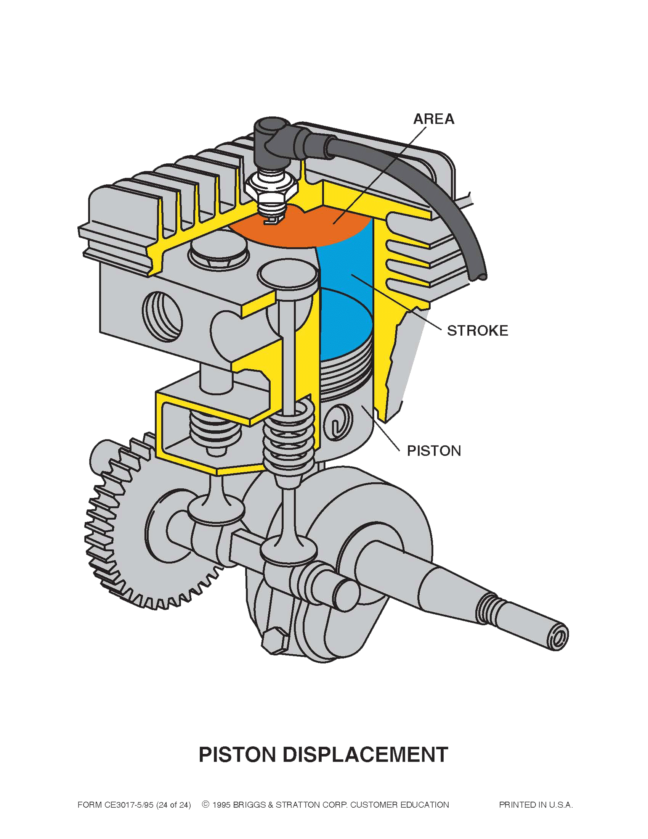
Valves next to cylinder
Lower production costs - Less parts
Lower compression ratio
L-HEAD
CE3017-10/11 of 86 .

Slide 27
Valves on top of piston
Runs cooler
Greater longevity
Higher compression ratio – More power and torque
Reduced emissions
OHV – OVERHEAD VALVE
CE3017-10/11 of 86 .

Slide 28
Valves on top of piston
Runs cooler
Greater longevity
Higher compression ratio - More power and torque
Improved sound quality
Less noise and vibration
Reduced emissions
DOV – DIRECT OVERHEAD VALVE
CE3017-10/11 of 86 .

Slide 29
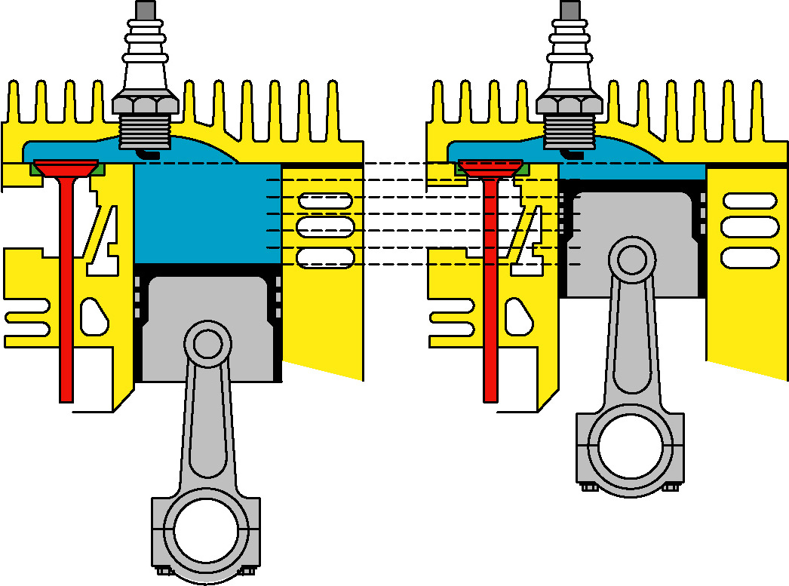
COMPRESSION RATIO 6 to 1
CE3017-10/11 of 86 .

Slide 30
COMPRESSION RATIO 8 to 1
CE3017-10/11 of 86 .

Slide 31
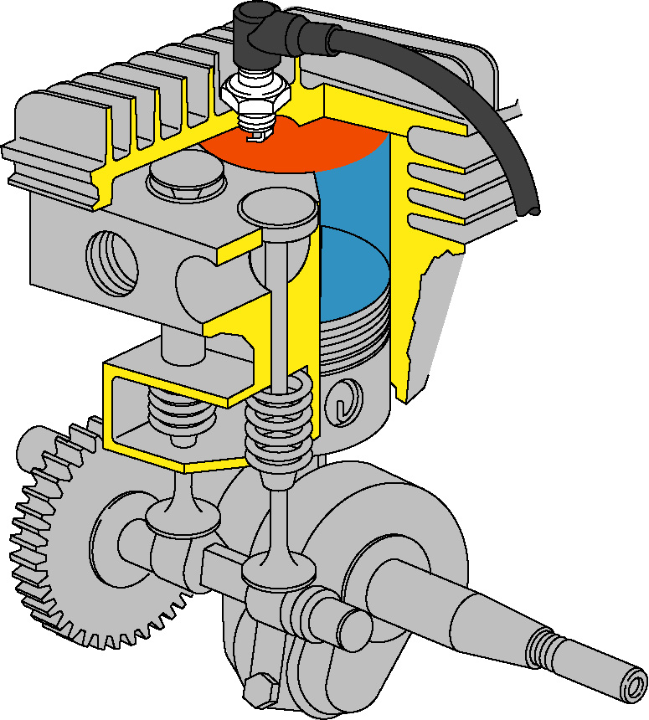
AREA (BORE)
STROKE
PISTON
FORMULA
D = .7854 x B² x S
PISTON DISPLACEMENT
CE3017-10/11 of 86 .

Slide 32
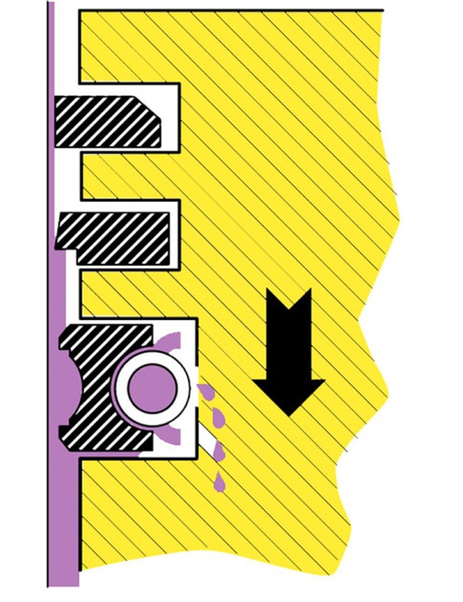
PISTON RINGS & LUBRICATION
CE3017-10/11 of 86 .

Slide 33
Ring Lands
PISTON RINGS & LUBRICATION
CE3017-10/11 of 86 .

Slide 34
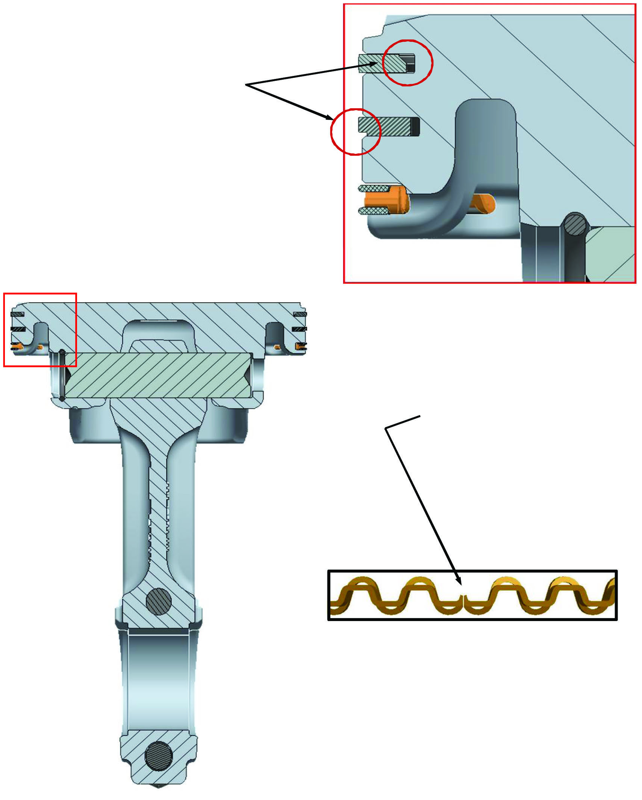
When installing the compression rings, the chamfers must be oriented as shown.
Expander gap ends must point toward piston crown when assembled.
PISTON RING INSTALLATION
CE3017-10/11 of 86 .

Slide 35
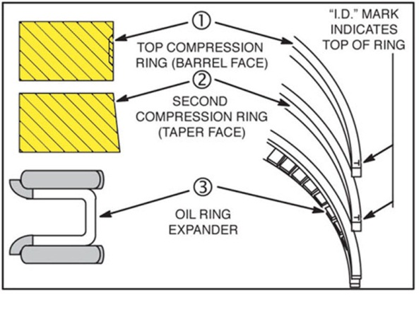
OUT
COMMON PISTON RING
ORIENTATION
CE3017-10/11 of 86 .

Slide 36
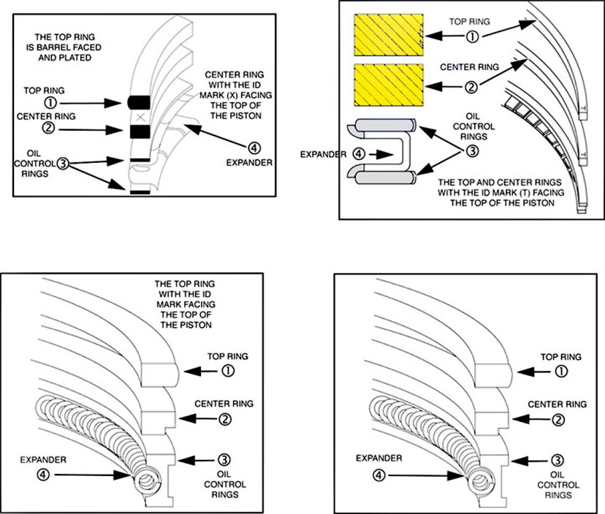
COMMON PISTON RING PACKAGES
CE3017-10/11 of 86 .

Slide 37
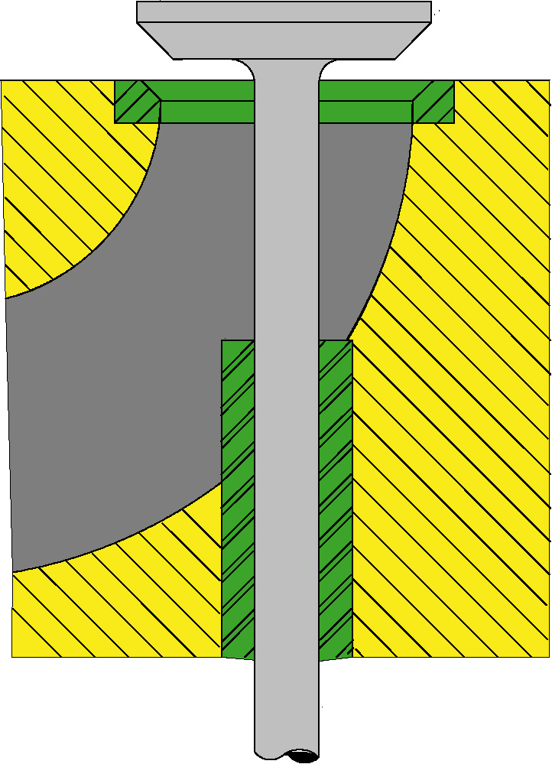
1. HEAD
2. MARGIN
3. FACE
4. SEAT
5. VALVE
GUIDE
6. STEM
VALVES
CE3017-10/11 of 86 .

Slide 38
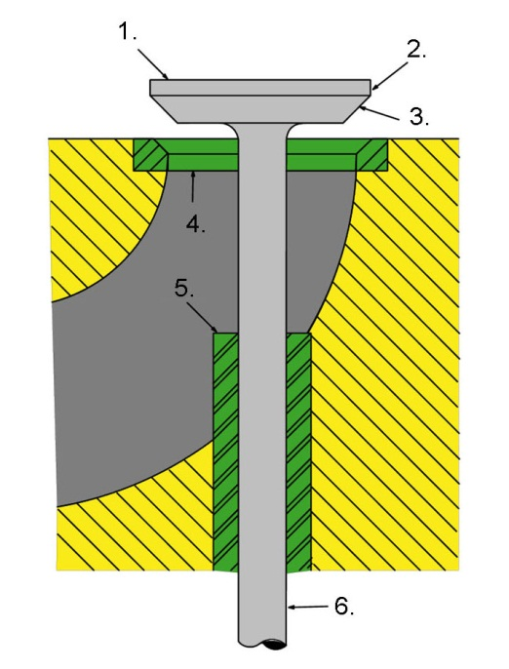
VALVES
CE3017-10/11 of 86 .

Slide 39
VALVE SEAT
VALVE STEM
INTAKE PORT
VALVE GUIDE
CYLINDER BLOCK
VALVES
CE3017-10/11 of 86 .

Slide 40
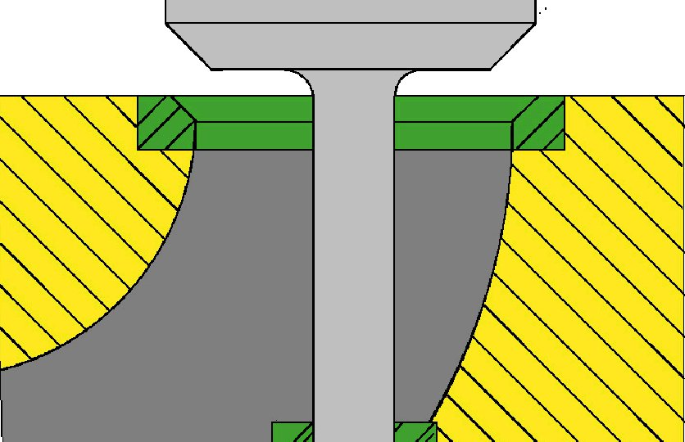
VALVE HEAD
MARGIN
VALVE FACE
VALVE SEAT
CYLINDER BLOCK
VALVE STEM
VALVES
CE3017-10/11 of 86 .

Slide 41
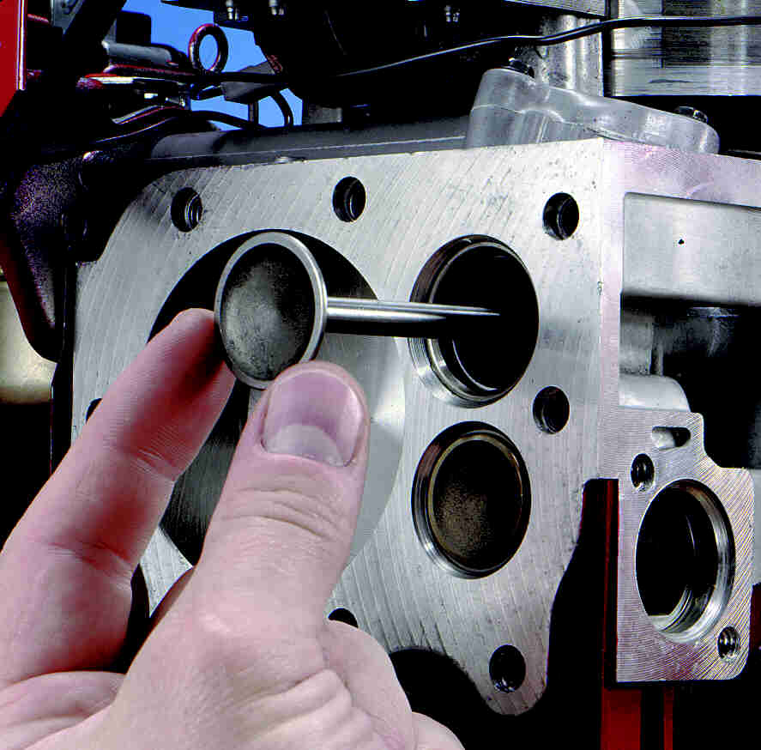
CYLINDER BLOCK
INTAKE PORT
EXHAUST PORT
VALVES
CE3017-10/11 of 86 .

Slide 42
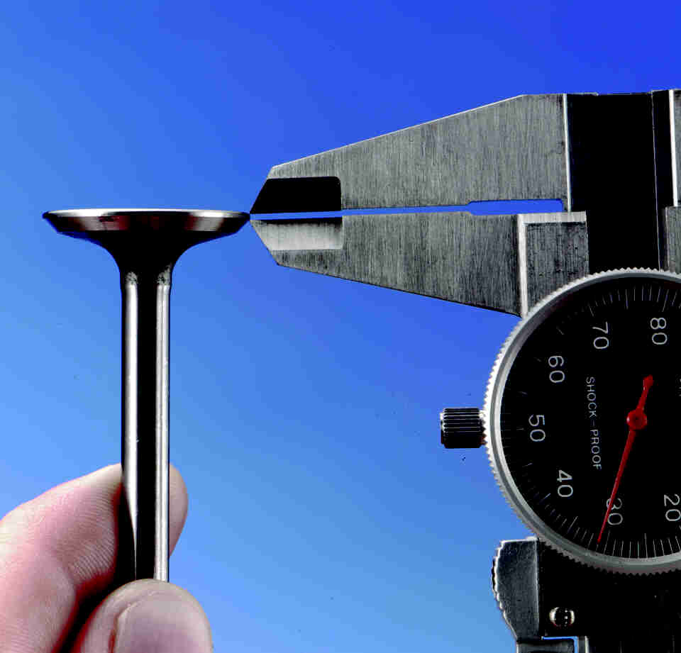
Measure the Margin
VALVES
CE3017-10/11 of 86 .

Slide 43
1/16″-3/64″
(0.8 MM-1.2 MM)
45º
Use a 60° cutter to narrow seat from bottom.
Use a 15° cutter to narrow seat from top.
60º Cutter
15º Cutter
45° Valve Seat Dimensions
1/32″ (0.8 MM)
Minimum
3/64″-1/16″
(1.2 MM-0.8 MM)
Seating Area Centered on Valve Face
Valve Dimensions
VALVE AND SEATS
CE3017-10/11 of 86 .

Slide 44
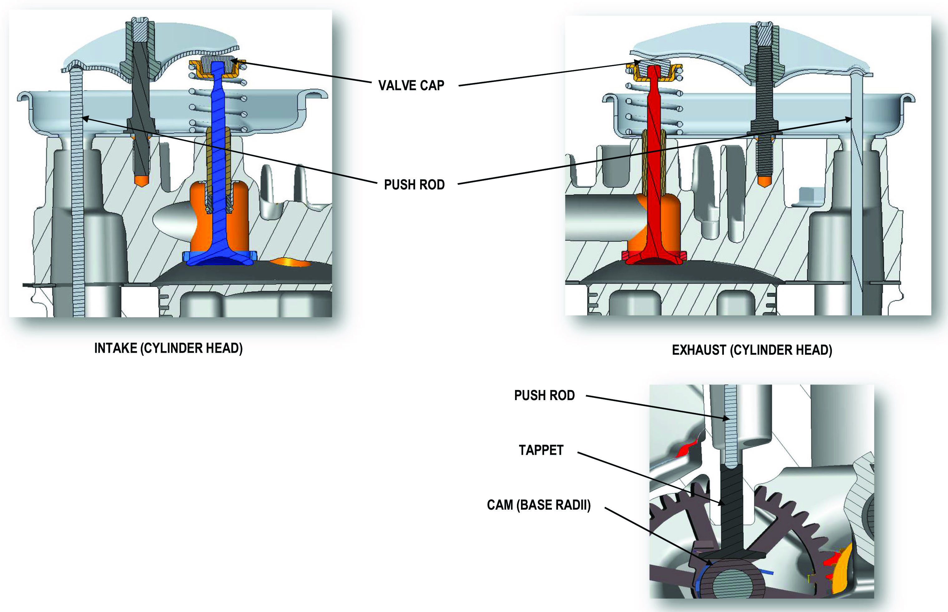
OHV NAMING CONVENTIONS
CE3017-10/11 of 86 .

Slide 45
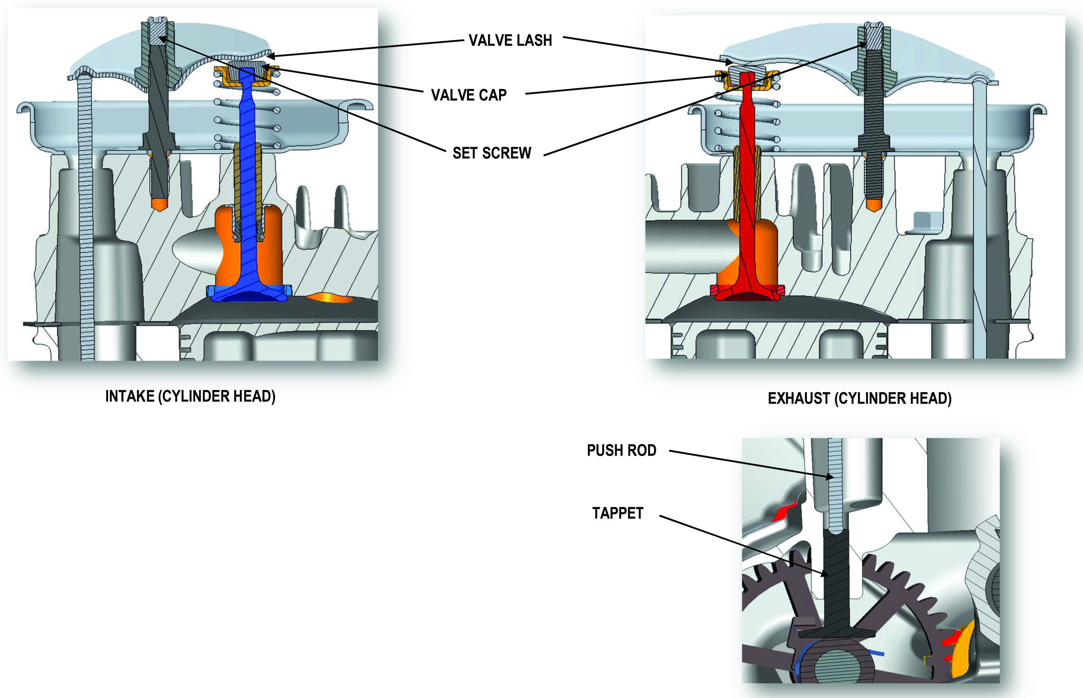
OHV NAMING CONVENTIONS
CE3017-10/11 of 86 .

Slide 46
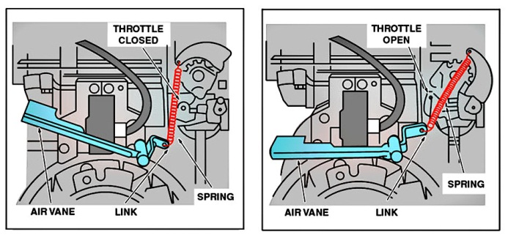
Engine Not Running
Engine Running
Vertical Shaft Engine
PNEUMATIC STYLE GOVERNOR
CE3017-10/11 of 86 .

Slide 47
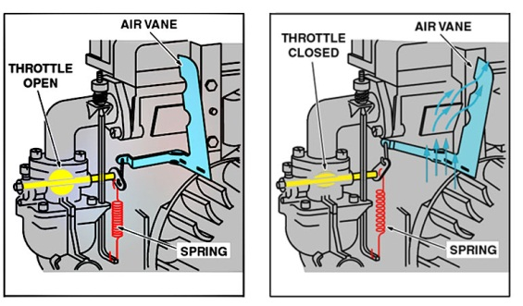
Engine Not Running
Engine Running
Horizontal Shaft Engine
PNEUMATIC STYLE GOVERNOR
CE3017-10/11 of 86 .

Slide 48
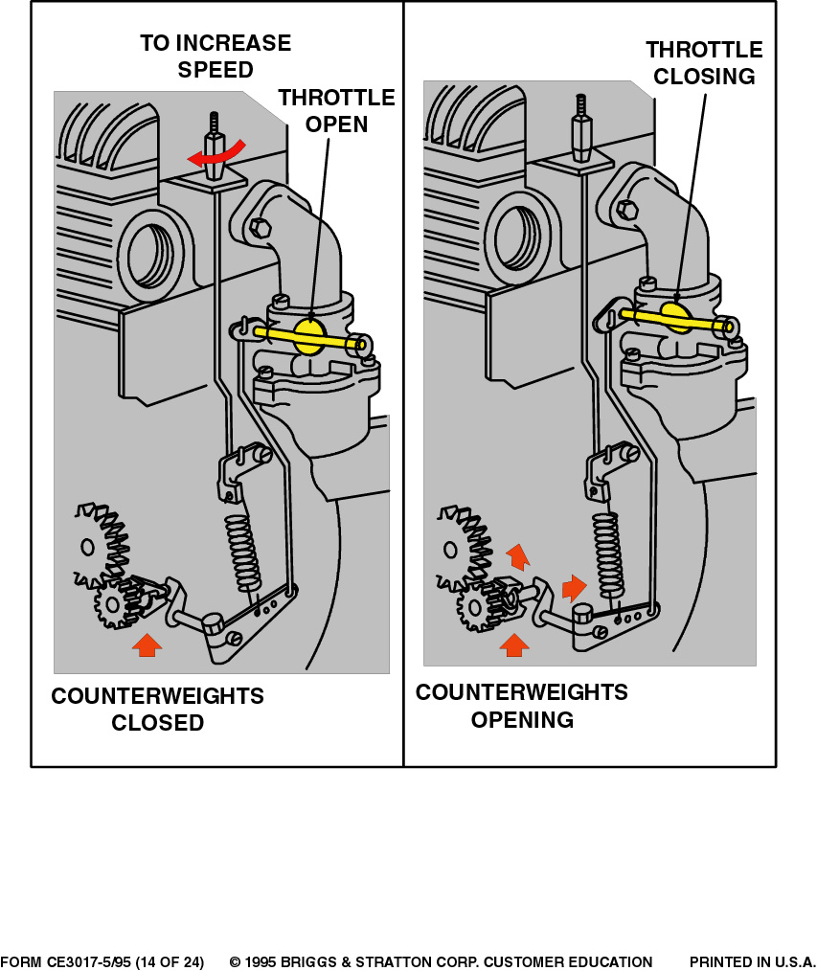
Engine Not Running
Engine Running
Horizontal Shaft Engine
MECHANICAL STYLE GOVERNOR
CE3017-10/11 of 86 .

Slide 49
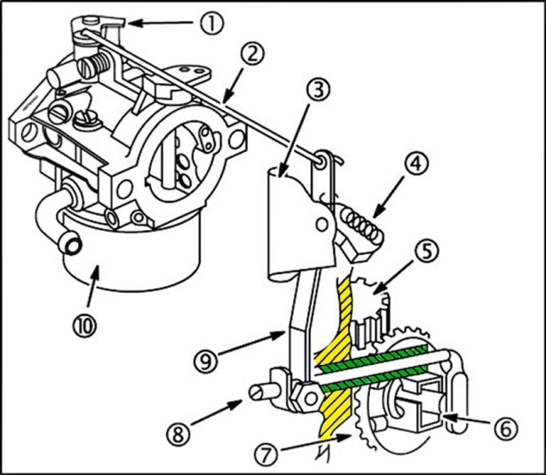
The governor spool is part of the oil
slinger and is removed as part
of the oil slinger.
Throttle Lever
Governor Link
Governor Bracket
Governor Spring
Cam Gear
Governor Cup
Governor Gear
Governor Shaft
Governor Lever/Arm
Carburetor
Vertical Shaft Engine
MECHANICAL GOVERNOR
CE3017-10/11 of 86 .

Slide 50
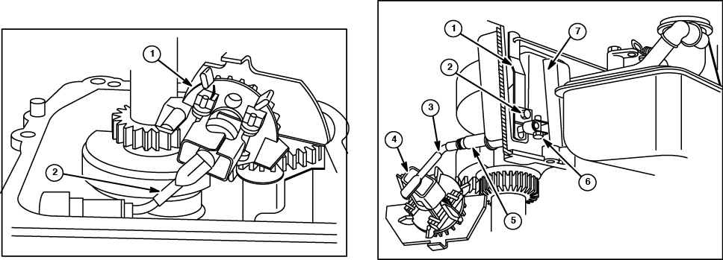
Fig. 1
(shows governor upside down)
Oil Slinger & Governor Spool
Governor Shaft
Fig. 2
Governor Lever/Arm
Governor Crank
Governor Crank
Governor Spool Fly Weights
Governor Shaft Bushing
Governor Arm Pinch Bolt & Nut
Vertical Shaft Engine
MECHANICAL GOVERNOR &
LUBRICATION SYSTEM
CE3017-10/11 of 86 .

Slide 51
ADJUST TOP NO LOAD SPEED
CE3017-10/11 of 86 .

Slide 52
Top Stop Nut
Lower Stop Nut
FIXED SPEED OPERATION
CE3017-10/11 of 86 .

Slide 53
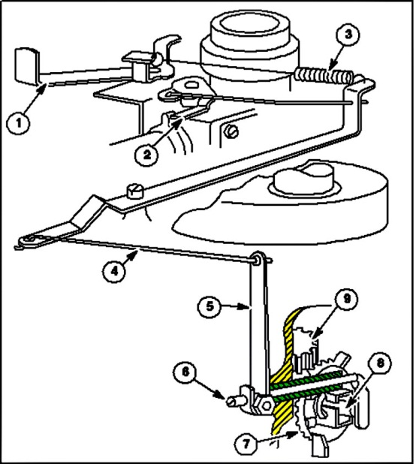
Governor Speed Lever
Throttle
Governor Spring
Link
Governor Lever
Governor Shaft
Governor Gear
Cup
Cam Gear
Vertical Crankshaft
MECHANICAL GOVERNOR SYSTEM
CE3017-10/11 of 86 .

Slide 54
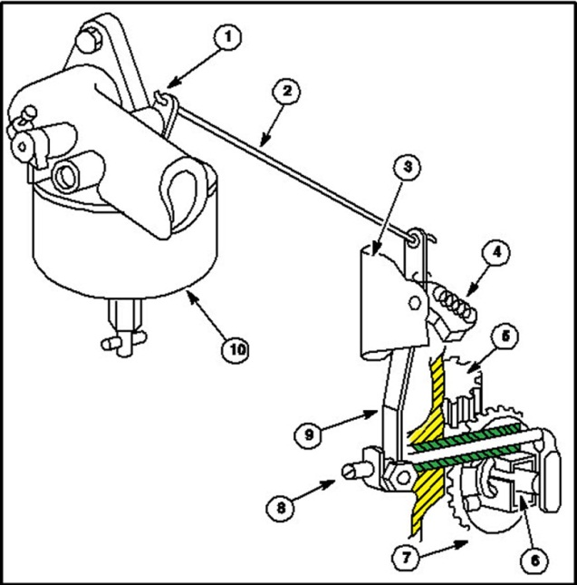
Throttle
Link
Governor Bracket
Governor Spring
Cam Gear
Cup
Governor Gear
Governor Shaft
Governor Lever
Carburetor
MECHANICAL GOVERNOR
CE3017-10/11 of 86 .

Slide 55
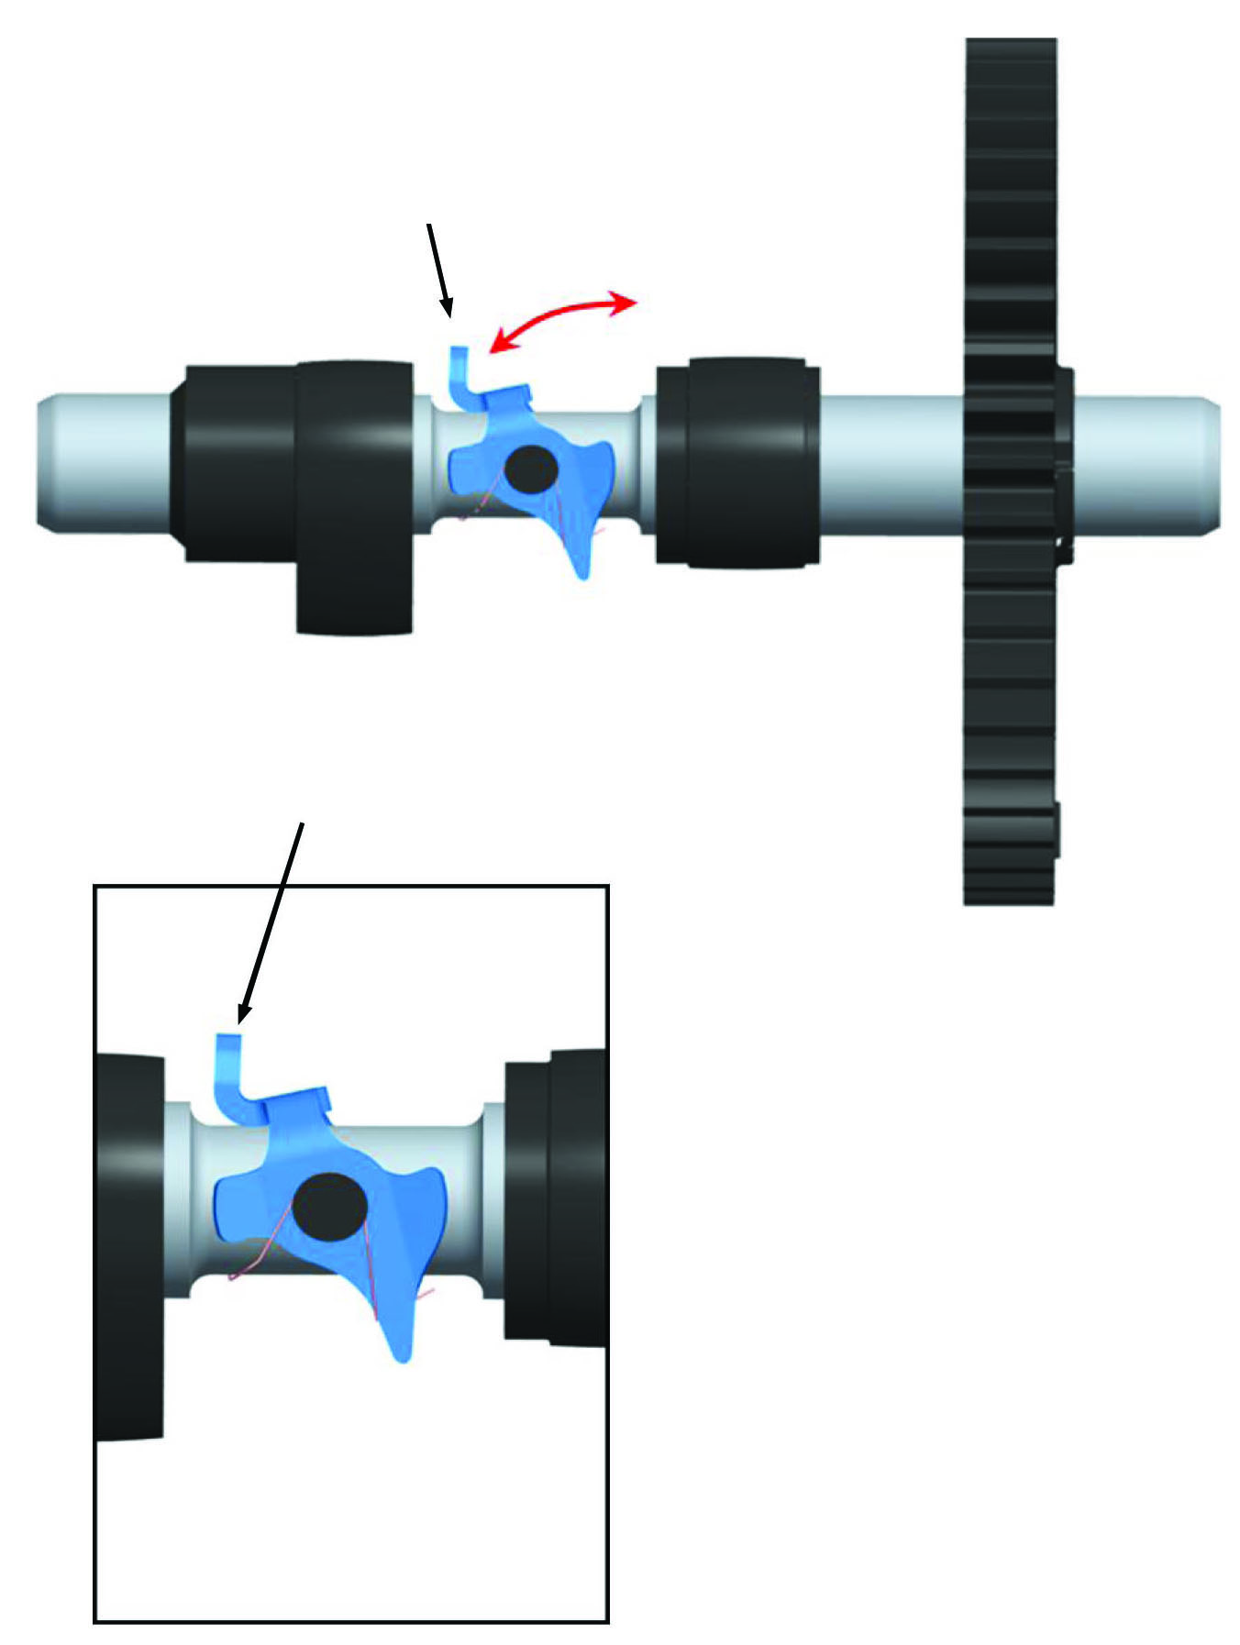
Check yoke operation before installing cam gear. Press yoke to “open” position, the release yoke must return to “closed” position.
MCR tab
CAM SHOWN WITH YOKE IN “CLOSED” POSITION
CE3017-10/11 of 86 .

Slide 56
Mechanical yoke-type compression releases use a spring loaded yoke (1) at the exhaust cam lobe to open the exhaust valve during starting.
Typical release mechanism shown in illustration.
When the engine starts, centrifugal force causes the yoke to overcome the spring (2) tension and swing away from the exhaust tappet, returning the engine to normal compression pressures in combustion chamber.
MECHANICAL COMPRESSION
RELEASE
CE3017-10/11 of 86 .

Slide 57
Mechanical yoke-type compression releases use a spring loaded yoke (2) at the exhaust cam lobe (1) to open the exhaust valve during starting.
When the engine starts, centrifugal force causes the yoke to overcome the spring (2) tension and swing away from the exhaust tappet, returning engine to normal compression.
MECHANICAL YOKE TYPE
COMPRESSION RELEASE
CE3017-10/11 of 86 .

Slide 58
This cam gear has a mechanical compression release on the exhaust cam lobe plus Easy-Spin® (1). In the starting position, the actuator cam (3) moves the rocker cam (2) so it will open the exhaust valve at the same time as the Easy-Spin® lobe opens the intake valve. When the engine starts, the actuator cam moves down and the exhaust valve operates normally.
MECHANICAL COMPRESSION RELEASE & EASYSPIN® CAM LOAD
CE3017-10/11 of 86 .

Slide 59
Governor slider (2) must move freely on journal of cam shaft. Flyweight must pivot freely. Make sure flyweight spring is not stretched. Governor weights must move freely on hinge pins.
Locating Pin
Governor Slider
Governor Weight
Gear Teeth
Springs
P.T.O. Journal
Compression Release Balls
Flyweight Pivot
Exhaust
Intake
Mag Journal
Flyweight
Governor Level
Vanguard™ V-Twin Horizontal
MECHANICAL GOVERNOR & COMPRESSION RELEASE
CE3017-10/11 of 86 .

Slide 60
Collar
Cotter Pin
Seal
Thrust Flange Down
Camshaft Bearing Support
Hinge Pins
Flyweights
Governor Spool
Governor Link and Spring
Governor Lever
Do Not Tighten Nut
Governor Idle
GOVERNORS
CE3017-10/11 of 86 .

Slide 61
Locating Pin
Governor Spool
“O”-Ring
Governor Shaft
Collar
Cotter Pin
Seal
Governor Shaft Bushings
GOVERNORS
CE3017-10/11 of 86 .

Slide 62
This model series utilizes two gear driven counterweights in constant mesh with the crankshaft gear.
The cut-away view illustrates these gears, mounted in the crankcase cover. The Synchro-Balance® counterweights rotate in opposite direction to crankshaft rotation.
Horizontal Crankshaft
ROTATING COUNTERBALANCE
CE3017-10/11 of 86 .

Slide 63
Journals
Gear Teeth
SYNCHRO-BALANCE®
ROTATING COUNTERWEIGHT SHAFT
CE3017-10/11 of 86 .

Slide 64
Briggs & Stratton uses two methods of internally balancing engines.
One system used driven counterweights that rotate in the direction opposite (180°) of the crankshaft counterweights, Fig. 1.
The other system uses a counterweight that oscillates opposite to the direction of the piston, Fig. 2. Each system performs the function of substantially reducing engine vibration, thereby giving exceptionally smooth engine performance.
CE3017-10/11 of 86 .

Slide 65
Woodruff Key
PTO Side Weight
Dowel Pin
Magneto Side Counterweight
Link
OSCILLATING COUNTERBALANCE SYSTEM
CE3017-10/11 of 86 .

Slide 66
Counterweight Pivot Shaft Bore
Connector Link Eccentric Bore
Connector Link
Counterweight Pivot Shaft
Snap Ring
Counterweight Link Pin Bore
Link Pin
Connector Link Pin Bore
Crankshaft Timing Gear
Counterweight Assembly
OSCILLATING COUNTERWEIGHT
CE3017-10/11 of 86 .

Slide 67
Install Screw
PTO Side Counterweight
Link
Rounded Edge of Free End
Dowel Pin
Crankshaft Eccentric
Magneto Side Counterweight
Crankshaft and Counterweight in a Vice
COUNTERWEIGHT ASSEMBLY
& CRANKSHAFT
CE3017-10/11 of 86 .

Slide 68
REMOVE COUNTERBALLANCE SYSTEM
Remove crankshaft.
Remove the crankshaft gear (6) from the crankshaft (1). If the gear is tight, pry it off using two screwdrivers, being careful not to damage the gear.
Remove the woodruff key (5) from the crankshaft.
Remove and discard the plastic alignment plug (3) from the Mag side of the counterweight (4). Slide the counterweight from the counterweight links (2).
Remove the counterweight links from the crankshaft.
Model Series 21A800, 21B800, 284H00, 285H00, 286H00, 28AH00, 28BH00, 28CH00, 31E700, 31F700, 31G700, 31H700, 31J700, 31K700, 31L700, 31M700
AVS™ BALANCE SYSTEM
CE3017-10/11 of 86 .

Slide 69
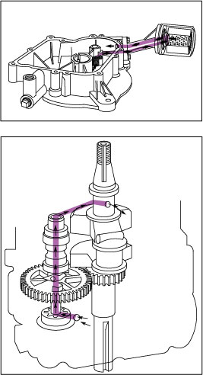
The pump draws oil from the sump and pumps it through the oil filter and back to the sump through a drain hole in the sump. Oil pump is driven by lower end of cam gear. Engine is lubricated by the oil stinger and governor gear assembly.
NOTE: This system does not supply oil under pressure to any of the bearing surfaces. This system pumps oil to the oil filter and back to the crankcase.
The oil pump is located in bottom of sump, and is driven by the camshaft. The oil pump supplies oil to the camshaft bearings and magneto bearing.
Oil enters the pump through a slot in the sump. The pump pushes oil through the hollow camshaft to the magneto camshaft bearing, and through a drilled passage to the crankshaft magneto bearing. The oil slinger lubricates the remaining bearings and journals.
PRESSURE LUBRICATION & FILTERED
CE3017-10/11 of 86 .

Slide 70
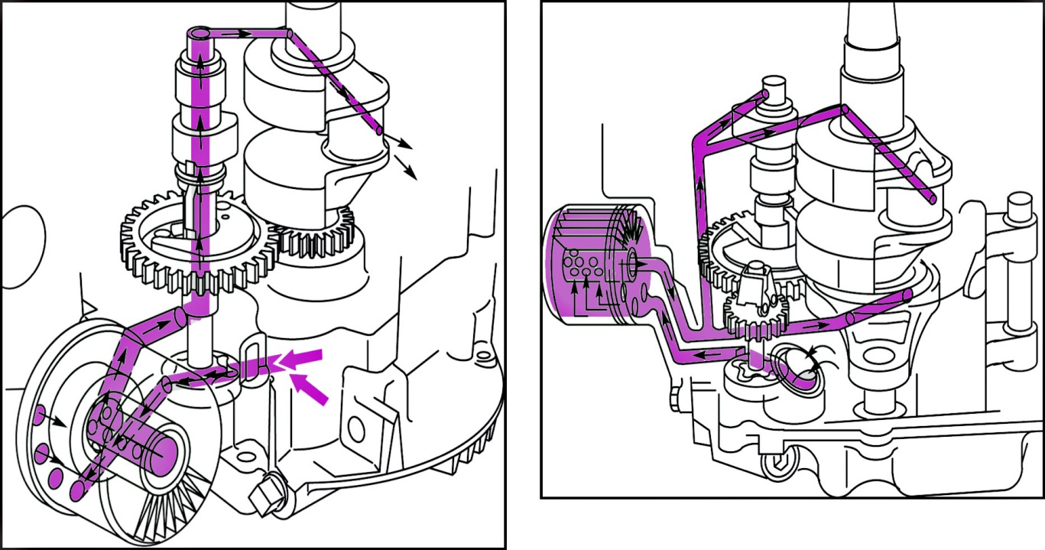
Oil Pump Applications
The oil pump supplies lubricant to the crankshaft main bearings, connecting rod crankpin bearings, camshaft bearings, and rocker arms.
PRESSURE LUBRICATION & FILTERED
CE3017-10/11 of 86 .

Slide 71

The pump draws oil from the sump and pumps it through the oil filter and back to the sump PTO bearing. The oil pump is driven by the camshaft and the oil pump drive shaft.
Oil Pump
PRESSURE LUBE SUMP
CE3017-10/11 of 86 .

Slide 72

Horizontal Crankshaft
Vertical Crankshaft
FULL PRESSURE
LUBRICATION SYSTEM
CE3017-10/11 of 86 .

Slide 73
Thread
Keyway
Oil Galleries
Oil Galleries
Crankpin
Timing Gear Teeth
P.T.O. Journal
Keyway
CRANKSHAFT
CE3017-10/11 of 86 .

Slide 74

OIL FILTER FLOW
CE3017-10/11 of 86 .

Slide 75
CRANKSHAFT-CAMSHAFT
CE3017-10/11 of 86 .

Slide 76

Typical Horizontal Crankshaft
FULL PRESSURE
LUBRICATION SYSTEM
CE3017-10/11 of 86 .

Slide 77

Typical Vertical Crankshaft
FULL PRESSURE LUBRICATION
SYSTEM
CE3017-10/11 of 86 .

Slide 78
LOW OIL PRESSURE SWITCH
CE3017-10/11 of 86 .

Slide 79
Horizontal Crankshaft
OIL PUMP
CE3017-10/11 of 86 .

Slide 80
Vertical Crankshaft
OIL PUMP
CE3017-10/11 of 86 .

Slide 81
Horizontal Crankshaft
GEROTOR STYLE OIL PUMP
CE3017-10/11 of 86 .

Slide 82
Vertical Crankshaft
GEROTOR STYLE OIL PUMP
CE3017-10/11 of 86 .

Slide 83
Horizontal Crankshaft
SPLASH LUBRICATION
CE3017-10/11 of 86 .

Slide 84

Cam Gear
Mechanical Compression Release
Timing Gear
Mechanical Governor Fly Weights
Oil Slinger and Governor Gear
Governor Cup
Single Cylinder “L-Head”
Vertical Crankshaft
SPLASH LUBRICATION
CE3017-10/11 of 86 .

Slide 85

FLYWHEEL KEY
CE3017-10/11 of 86 .

Slide 86

Slinger/Governor Assembly
Slinger/Governor assembly must be aligned with governor crank
OILING AND MECHANICAL GOVERNOR
86
CE3017-10/11 of 86 .

